Slide 1

AI for Businesses

Slide 2

Agenda
Transformer Architecture – Advances in AI
Training LLMs – RAG versus Fine Tuning
AI for business – RAG models explained
Demo use case – Enterprise Search and Queries
Neuranet Wingman

Slide 3
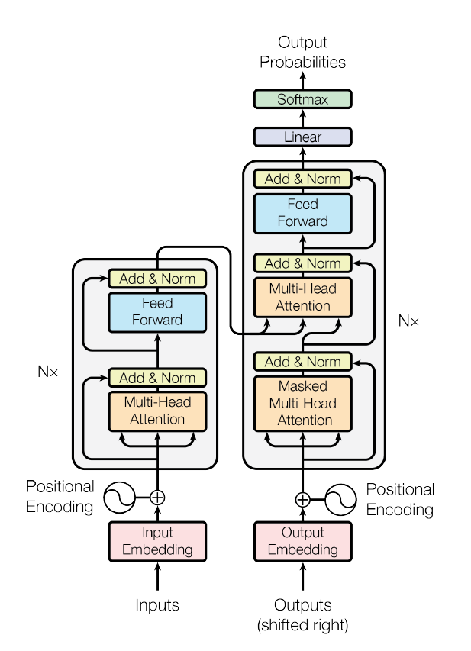
AI – Large Language Models
Transformer architecture is the the core algorithm behind latest LLMs
The big advance is parallelism versus RNN (Recurrent Neural Networks) which were sequential using multiheaded attention and location vectors.
This allows a much “larger” amount of data to be used to train the AI as it can be done in parallel, resulting in “large” language models.
Inference is done by the decoder portion of the LLM architecture, and the transfer weights are frozen post training – thus, inference uses only the pre-trained weights and it is computationally inexpensive, while being GPU memory sensitive.

Slide 4
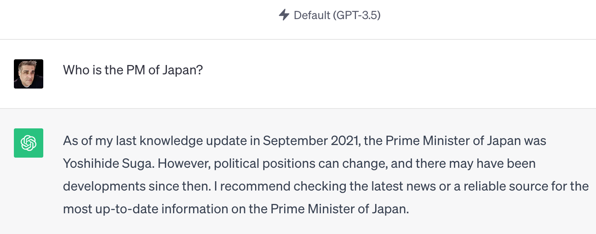
Retraining AI LLMs
LLMs are frozen post training. For example – GPT by OpenAI uses training dataset from September 2021.
Business needs real time answers, even 1 hour makes trading information useless, for example. This implies retraining LLMs continually.
Fine Tuning – This implies changing the neural network weights and rebuilding the LLM model.
It is computationally intensive
It needs labeled data, which implies a team of humans is constantly retraining it.
RAG Training – Latest advance in LLM training.
It can be real-time.
It is not computationally expensive.
It does not need labeled data.
RAG is the only realistic training methodology to build and deploy LLMs in business.

Slide 5
RAG Training
RAG full form – Retrieval Augmented Generative LLMs.
RAG models take a base LLM, but use it for word prediction only, i.e. the decoder stage.
A RAG LLM model uses other task specific AI models for processing the input, retrieving the data and forming the final solution.
The last stage of a RAG architecture is to use a general purpose LLM to generate the final English textual answer.
This allows RAG models to be real-time, constantly retrainable and task specific.

Slide 6
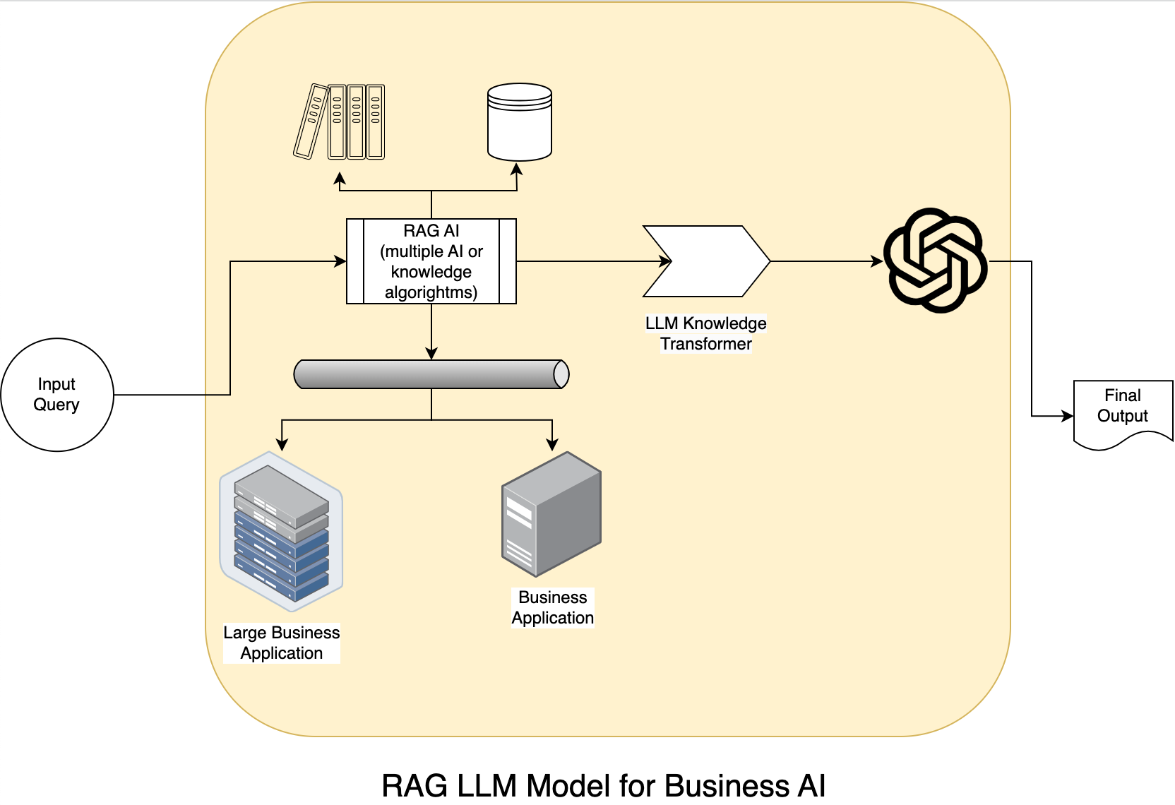
RAG LLM Models for Business

Slide 7

Enterprise AGI – RAG models are very complex
The three core Enterprise AI Problems
AIs need to be real-time or near real-time constantly re-trained (private brains), not trained on data from September 2021. Businesses run in realtime.
AIs need to have that real-time confidential information about "our business" (integration), which is not available on the public internet. So public AI will never have this information.
AIs need to absolutely produce an answer based only on those real-time facts using potentially confidential information. And cite their sources as proof. (no made up stuff)

Slide 8
Enterprise AGI – RAG AI Layers
Enterprise AI Solution a complete RAG framework consists of
AI Integration layer – to integrate business applications, events and data that the AI needs for both context and retraining
AI Data layer – Using AI specific data stores like Vector Databases, Document rank algorithms, business data to LLM knowledge encoders
Decoder Engine – To process the query and the required data surrounding the query for the LLM decoder to use in the last step.
Verification Layer – To ensure the final answer is based on facts and fact only and reject any made up answers.
Security Layer – This ensures we are not leaking confidential information. The answer includes information which the current user is authorized to access as per their role, including role-based security.

Slide 9
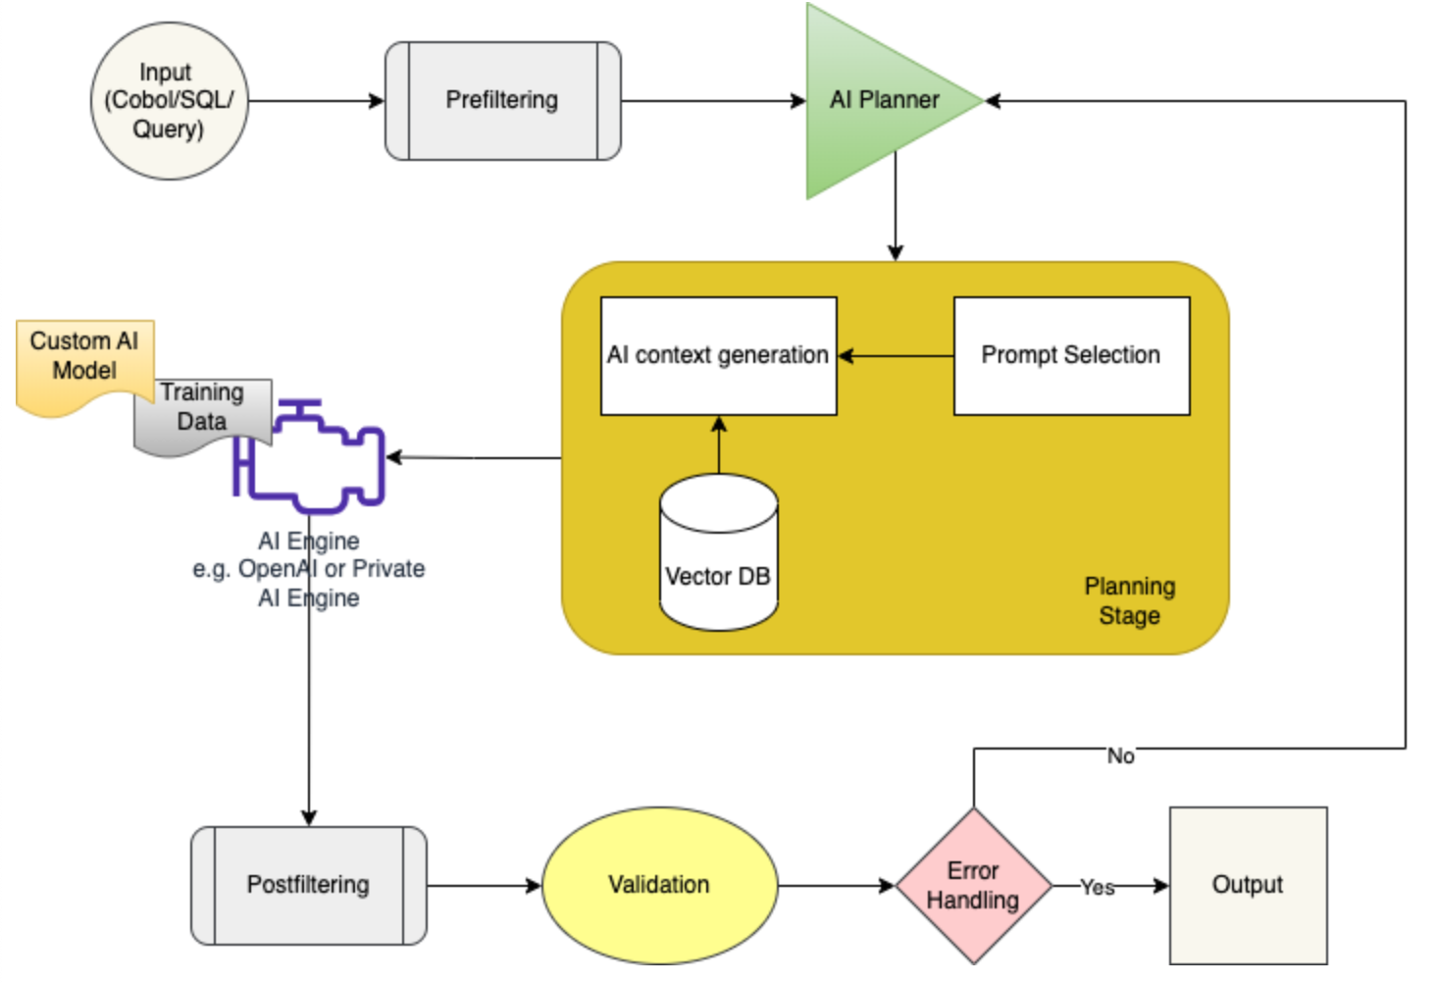
Tekmonks Neuranet AI – AI RAG LLM for businesses

Slide 10
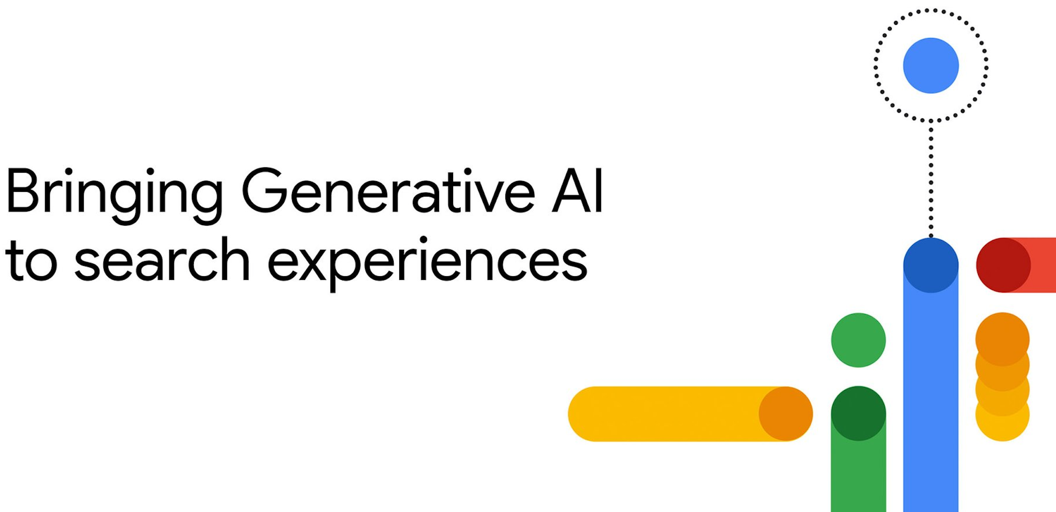
Demo Use Case – Enterprise AI Super Search
Tekmonks teams are working to enhance search for Enterprises
AI Training – Teams are continually refining and training the AI models to businesses knowledge catalog and custom data, infusing it with incoming real time feeds.
Verification – Custom verification pipelines to ensure the generated response is correct and based only on the fund and feed data.
Language Generation – Enhancements to the decoder stage to process complicated queries and transform them to search criteria and filters for super-search automatically.
Confidentiality – The training and data are confidential and hosted locally in the business' Git repository.
Future Enhancements – Enhance to better LLM models, including open-source models for full inhouse solution.

Slide 11


